Slide 1

Leveraging NLP and Deep Learning for Text Classification
Bonyshree Bose
Kanha Baidya
Yashesh Darji
Anirudh Bhamidipati

Slide 2
Agenda
Project Objectives
Purpose and Objectives
Data Collection and Preprocessing
Source of Data
Data Cleaning and Transformation
Feature Extraction
Techniques Used (e.g., TF-IDF, Word Embeddings)
Model Selection and Training
Supervised Models
Deep Learning Models
Evaluation and Results
Metrics and Performance
Confusion Matrix Analysis
Case Studies and Applications
Real-world Examples
Impact and Benefits
Challenges and Solutions
Common Issues
Mitigation Strategies
Future Work and Conclusion
Potential Improvements
Final Remarks

Slide 3

Project Objectives
nion
Goal:
Enhance Decision-Making
Automate Text Analysis
Improve Accuracy and Precision
Handle Diverse Text Data
Objectives:
Develop a robust text classification system using NLP, supervised models, and deep learning techniques to accurately classify text data and drive impactful insights

Slide 4
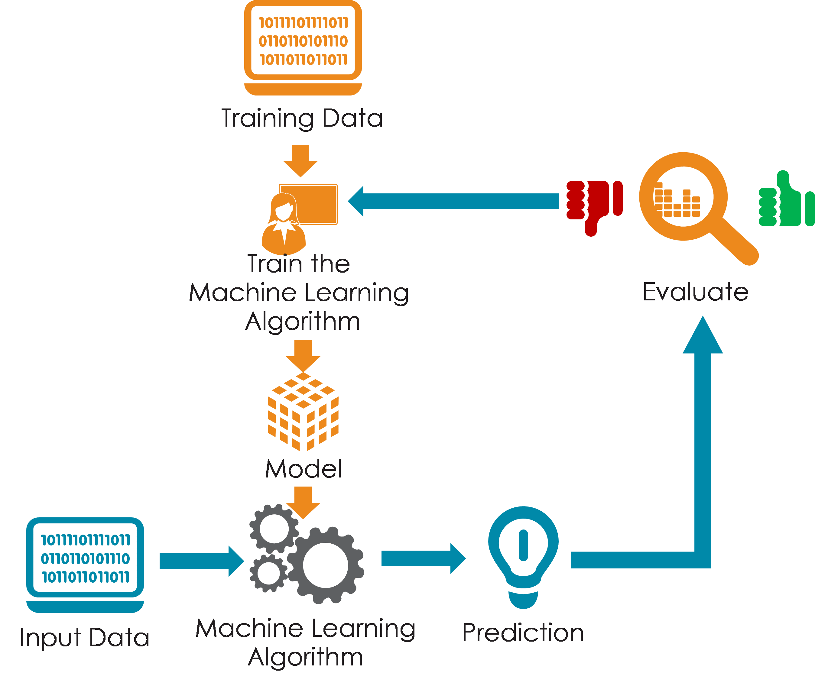
Agenda
Overview
Consumer complaints datasets
Data Pre-processing and Cleaning
Encoding

Slide 5
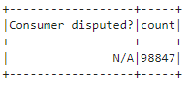
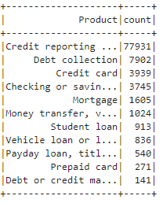
Data Collection
3 Month Data
CFPB Database
A comprehensive dataset containing consumer complaints about financial products and services, including company responses and consumer feedback.
11 Product Categories

Slide 6
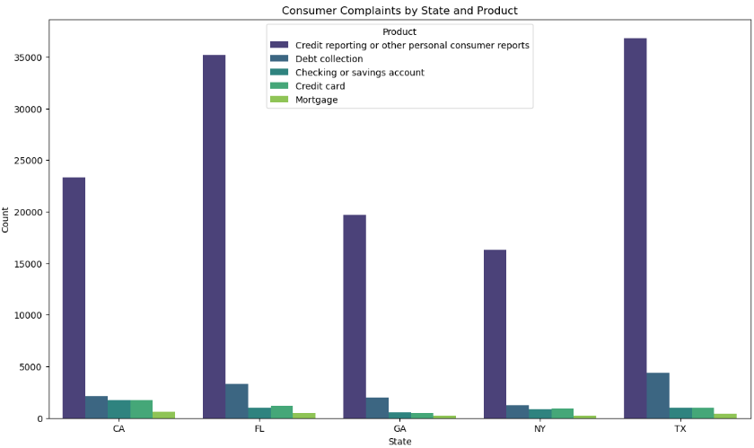
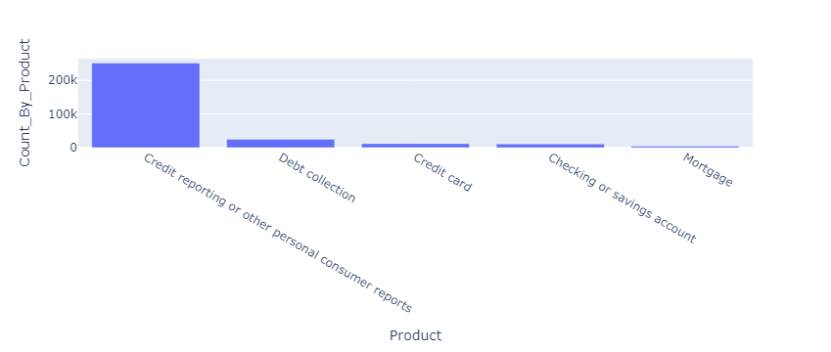
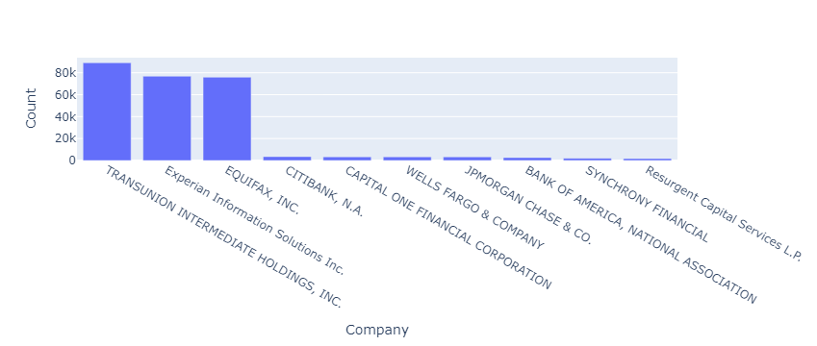
Data Cleaning

Slide 7
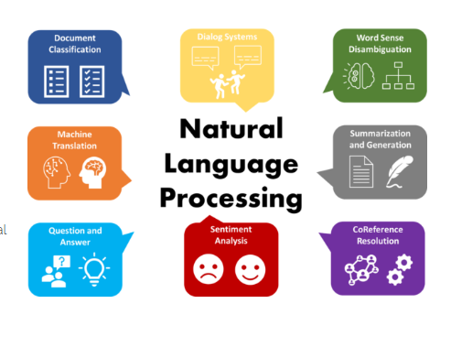
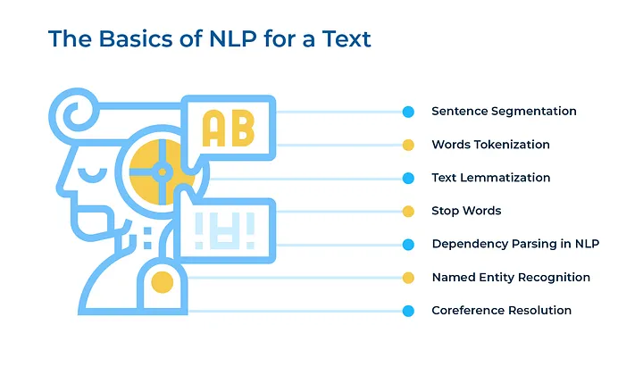
Data Pre-Processing
Original Text | Processed Text
my xxxx instructed me to write a letter because i am a xxxx of xxxx xxxx. i am in a desperate need to fix this problem since i am trying to get things in order the accounts that i put below are due to the xxxx xxxx violation that has nearly ruined my life please remove these accounts so i can start taking steps to getting my life back together. thank you so much for assisting me and offering these resources to xxxx like me. account that are fraud due to xxxx xxxx : xxxx. xxxx xxxxxxxx xxxx xxxx opened xx/xx/xxxx xxxx. xxxx xxxxxxxx xxxx xxxx opened xx/xx/xxxx xxxx. xxxx xxxx xxxx opened xx/xx/xxxx xxxx. the xxxx inquiries below | the only inquiry i did was the xxxx xxxx xxxx in xxxx, xxxx | step offering put desperate thing trying together write since account fithis instructed letter need please back like inquiry much violation nearly start opened order life resource get problem taking due remove getting assisting thank fraud ruined

Slide 8
Model Training – Supervised Model
Logistic Regression
Random Forest

Slide 9
gistic Regression:
Supervised Model - Logistic Regression
NLP Structured Dataset
PREPROCESSING
TF-IDF Vectorization (Text Features)
Label Encoding (Target Labels)
TRAIN-TEST SPLIT
Split Data
80% Train, 20% Test
MODEL TRAINING
Parameters: Max Iterations = 1000 Random State = 42
MODEL PREDICTION
Predicted the test
Product Categories

Slide 10
Results:
Metric | Class “0” (Checking or Savings Account) | Class “1” (Credit Card) | Overall/Weighted
Precision | 92% | 92% | 92%
Recall | 91% | 92% | 92%
F1-Score | 92% | 92% | 92%
Model Accuracy : 91.93%

Slide 11
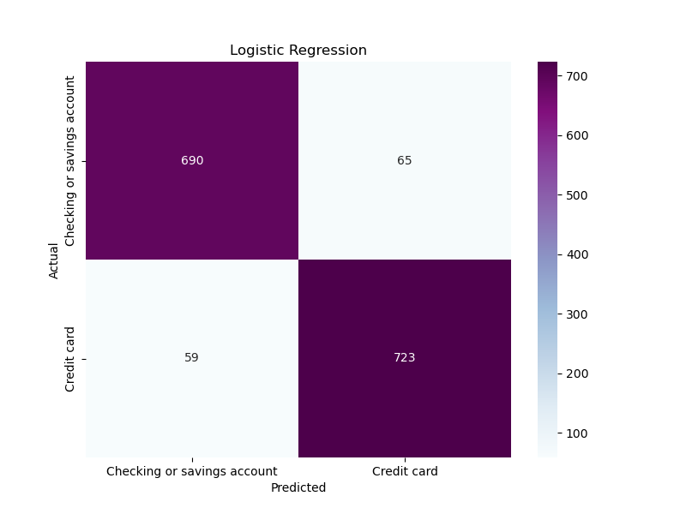

Slide 12
Supervised Model - Random Forest
The Random Forest Model's goal is to combine smaller models to make better predictions
The Random Forest Model that was created predicted an Accuracy score of around 92%
To calculate the precision score, a confusion matrix was created to see how the model performs for each class
The confusion matrix was able to search the model thoroughly highlighting important information that helped look into potential biases or imbalances in the models predictions

Slide 13
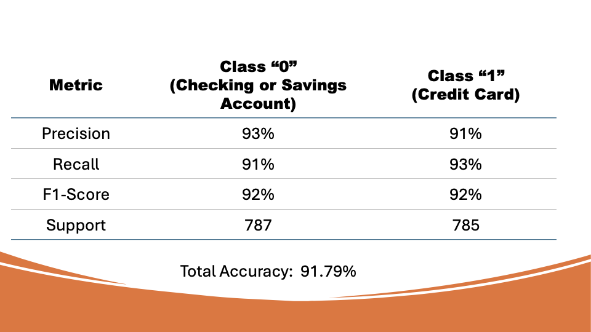

Slide 14
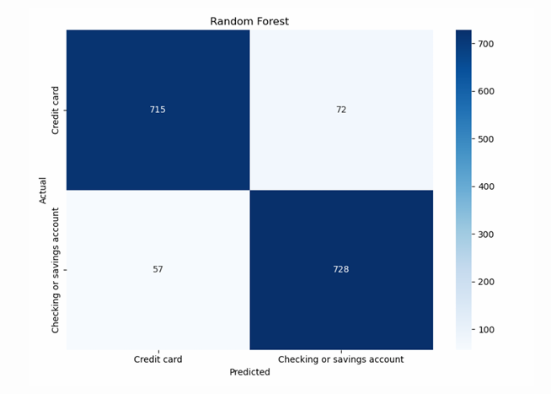

Slide 15
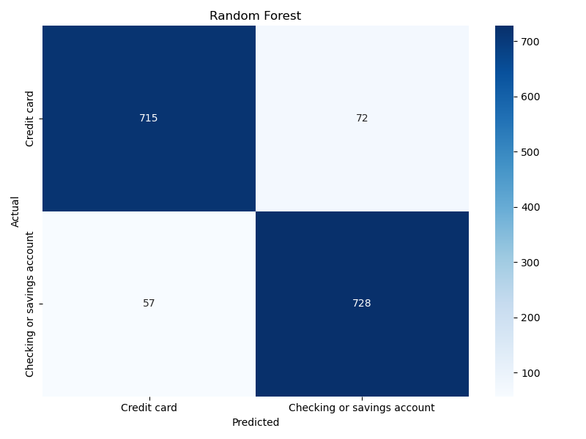

Slide 16

Deep Learning
BiLSTM with Trainable Embedding
BiLSTM with Pre-trained Embedding(GLoVe)

Slide 17
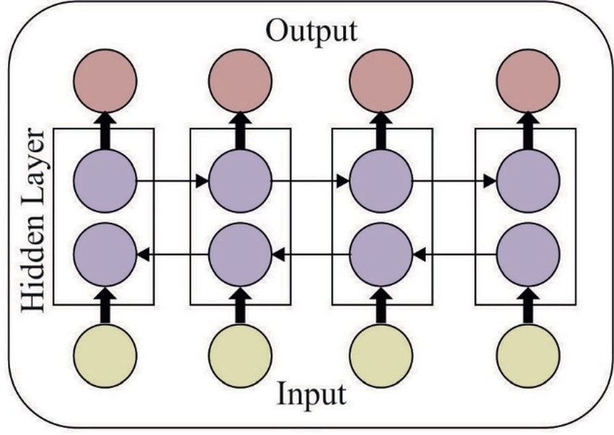
BiLSTM:
Imagine you have a sentence: "The cat sat on the mat."
Forward LSTM reads the sentence as: "The → cat → sat → on → the → mat."
Backward LSTM reads the sentence as: "mat → the → on → sat → cat → The."

Slide 18
BiLSTM Arcitecture:

Slide 19
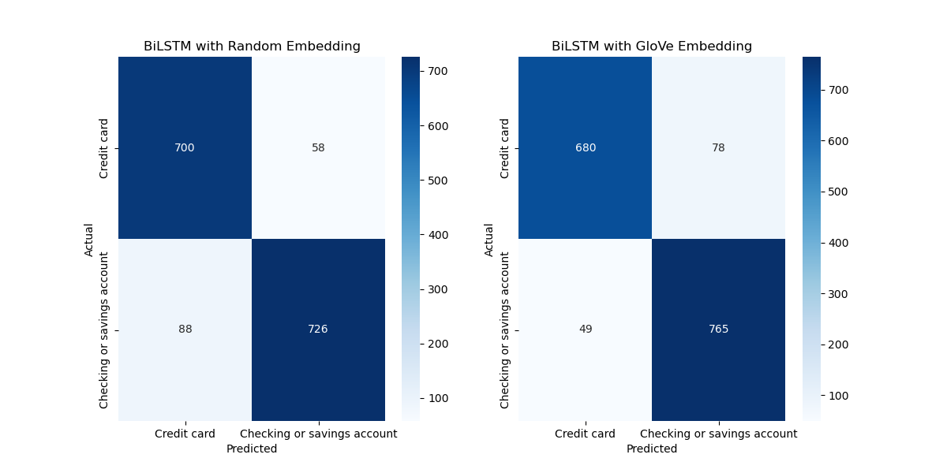


Slide 20
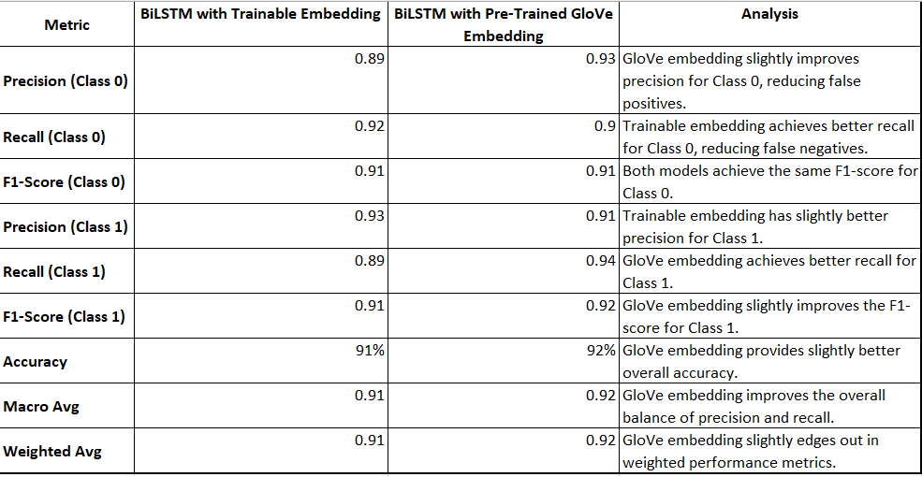

Slide 21

Acurracy Score:
BiLSTM with non-trained vector accuracy is 0.9071.
BiLSTM with pre-trained vector accuracy is 0.9192.

Slide 22

Case Studies
Case Study Objective : Automating Customer Support
To classify consumer complaint case information into correct Product Category such as Checking or Savings Account or Credit Card.

Slide 23

Challenges and Solutions
Challenge : Large Dataset and less computing power
Solution : Picked two Product categories to create the ML model for text classification

Slide 24

Future Work and Conslusion
Future Model Improvement: Explore models to classify between all 11 Product Categories.
Current Model Performance: The final model provided satisfactory results, although there is room for further improvement.
Current Key Findings: The preprocessing and feature extraction steps were crucial in enhancing model accuracy and ensuring robust performance.

Slide 25

Q&A

Slide 26

References
Consumer Financial Protection Bureau. "Consumer Complaint Database." Consumer Financial Protection Bureau, n.d. Web.
Predictive Analysis of CFPB Consumer Complaints Using Machine Learning - Dhwani Vaishnav, Manimozhi Neethinayagam, Jongwook Woo Published in arXiv.org 8 July 2024
NLP Processing :
https://medium.com/litslink/a-complete-guide-to-natural-language-processing-nlp-381bbac30962
Deep Learning Model :
https://www.geeksforgeeks.org/deep-learning-introduction-to-long-short-term-memory/
https://github.com/Ashwin-ks/NLP_Complaints_Classification_ML_DL

Slide 27
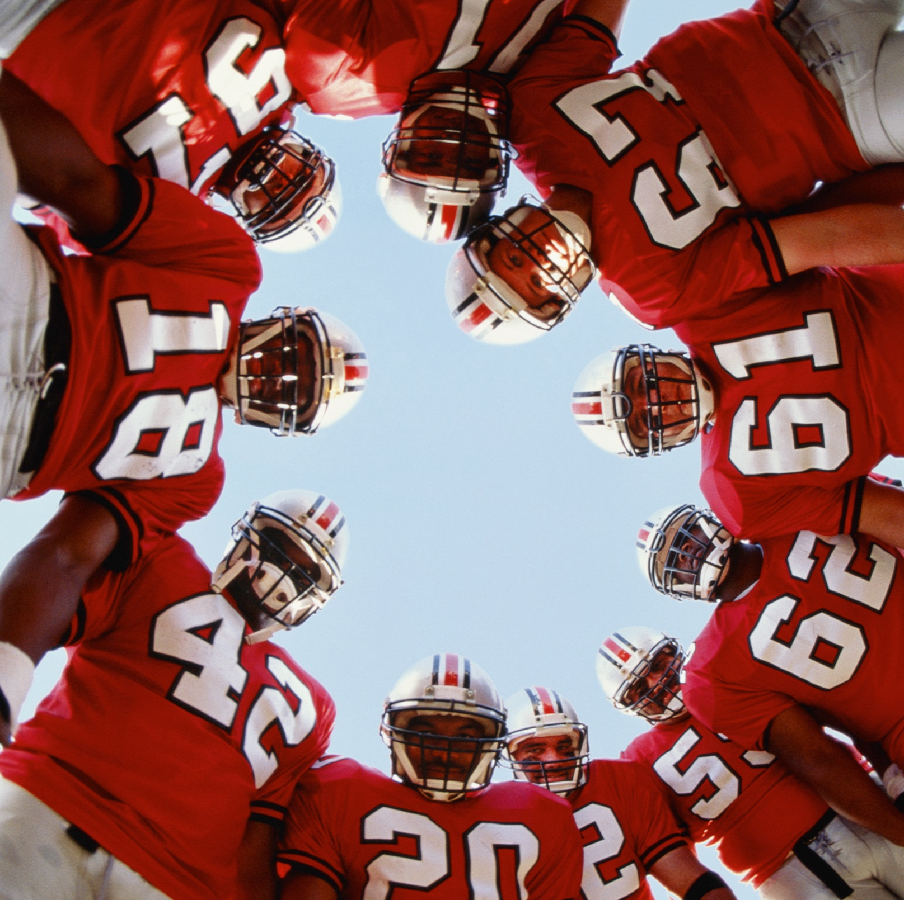
Thanks

Slide 28
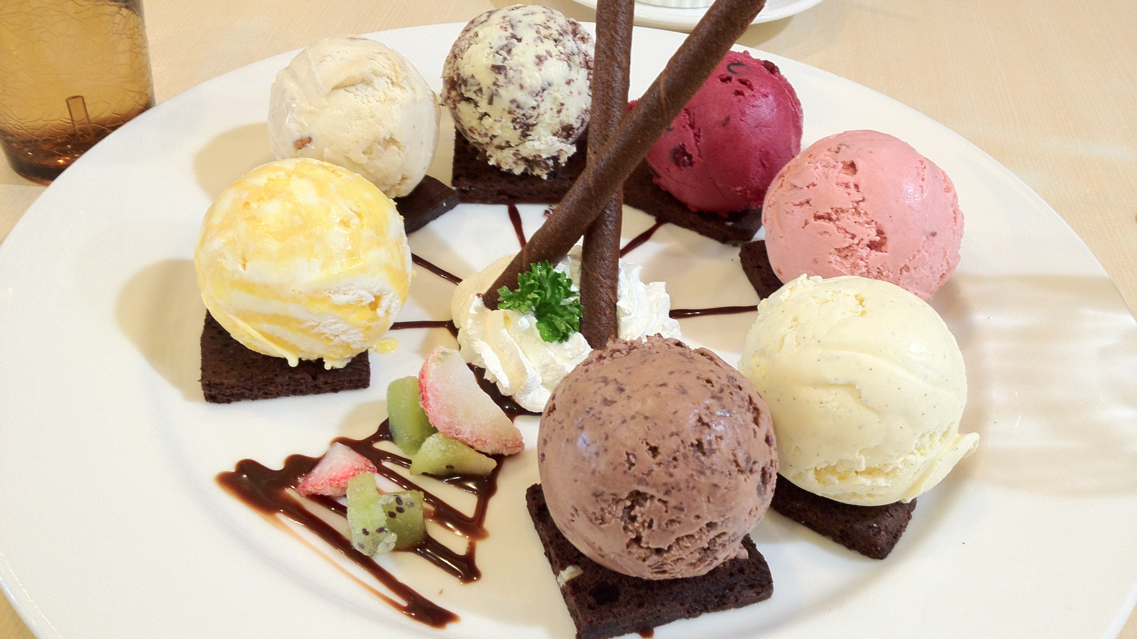
Thanks Dave and Arin
This Photo by Unknown Author is licensed under CC BY-SA

